Slide 1
Predictive Remaining Useful Life Estimation
NASA C-MAPSS turbofan engines
Final academic machine learning project
Notes:
Source: NASA C-MAPSS data and Saxena et al. (2008), DOI 10.1109/PHM.2008.4711414. The data are simulated, not live aircraft measurements.

Slide 2
Dataset and prediction target
26 raw fields per cycle
Engine ID, cycle, 3 operating settings, 21 sensors
Training trajectories run to failure
Test trajectories stop early. Predict remaining cycles at the last observed cycle.
Four subsets: FD001, FD002, FD003, FD004
Notes:
Source: docs/SOURCE_PROVENANCE.md and reports/dataset_summary.csv. FD001–FD004 are the modeled subsets; the original PHM08 challenge train.txt package is distinct.

Slide 3
Preprocessing and leakage controls
Raw data checks
Missing values, duplicates, engine-cycle keys, numeric types and cycle order
RUL label
Final training cycle minus current cycle. Official test RUL is an evaluation label.
Leakage boundary
Split by engine. Use only current and earlier sensor readings. Never use RUL as an input.
Notes:
Source: src/cmapss_pipeline.py, reports/PREPROCESSING_SUMMARY.md, docs/MODELING_PROTOCOL.md. Modeling reloads raw data and fits feature selection inside the engine-wise split.

Slide 4
Model selection protocol
1 Hold out 20% of training engines
2 Choose one partial-history endpoint per held-out engine
3 Compare models using validation RMSE
4 Refit the winner on all training engines
5 Evaluate once on official test endpoints
Notes:
Source: docs/MODELING_PROTOCOL.md. The candidates are the median baseline, Ridge regression, Random Forest and Histogram Gradient Boosting. The official test answers are excluded from model selection.

Slide 5
Official test results
Subset
Selected model
MAE
RMSE
R²
FD001
Random Forest
21.21
28.68
0.52
FD002
Histogram Gradient Boosting
20.27
27.66
0.74
FD003
Histogram Gradient Boosting
23.89
34.81
0.29
FD004
Histogram Gradient Boosting
27.72
38.50
0.50
Lower MAE and RMSE are better. These are benchmark results, not deployment guarantees.
Notes:
Source: reports/modeling/official_test_summary.csv. RMSE and MAE are measured in cycles. The selected model was chosen on validation data before official-test evaluation.

Slide 6
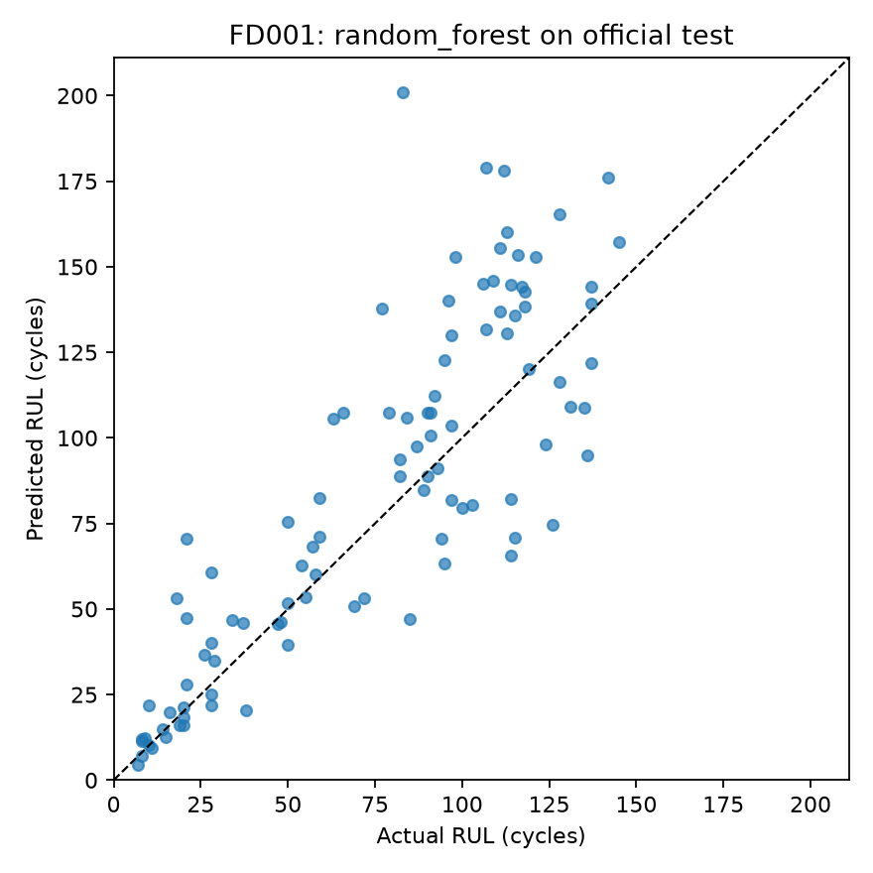
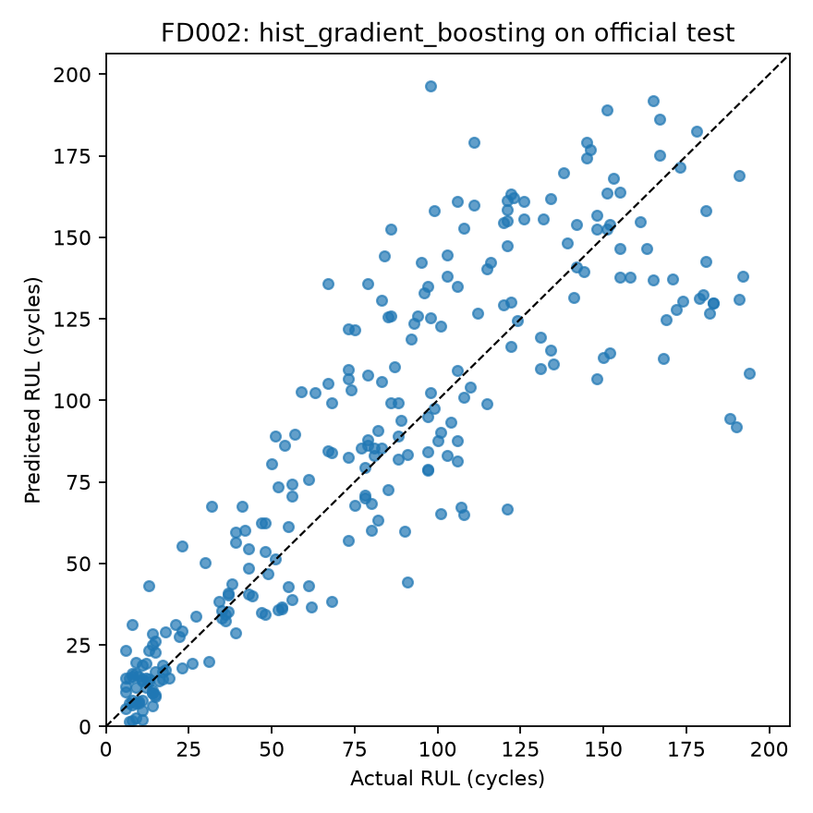
Predicted versus actual RUL
FD001
FD002
Notes:
Source: reports/modeling/FD001/official_test_actual_vs_predicted.png and reports/modeling/FD002/official_test_actual_vs_predicted.png. Each point is one official test engine.

Slide 7
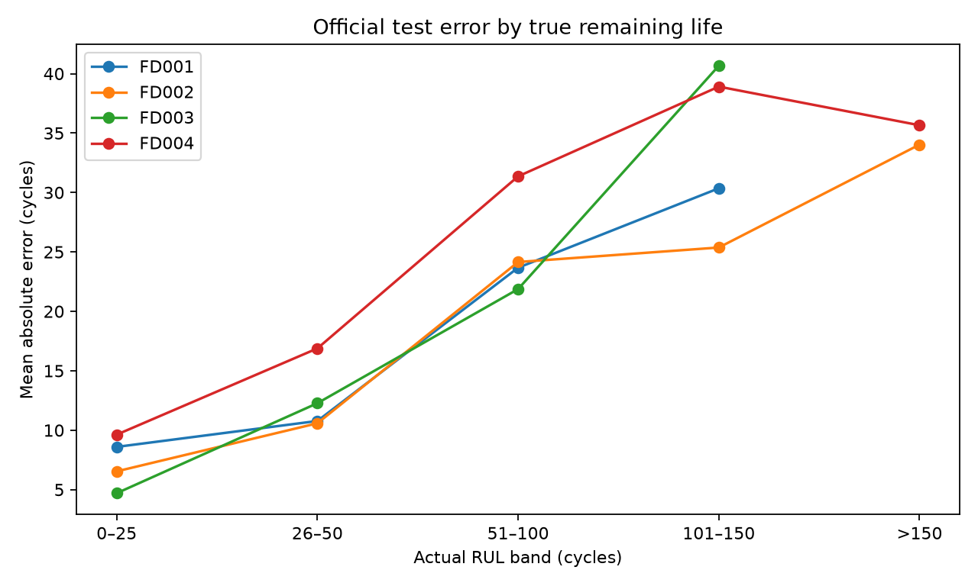
Error analysis
Overestimated life
FD001 65 / 100
FD002 150 / 259
FD003 76 / 100
FD004 175 / 248
Large individual errors remain.
Notes:
Source: reports/modeling/error_direction_counts.csv and reports/modeling/error_by_rul_band.png. Overestimation means predicted remaining life exceeds actual remaining life.

Slide 8
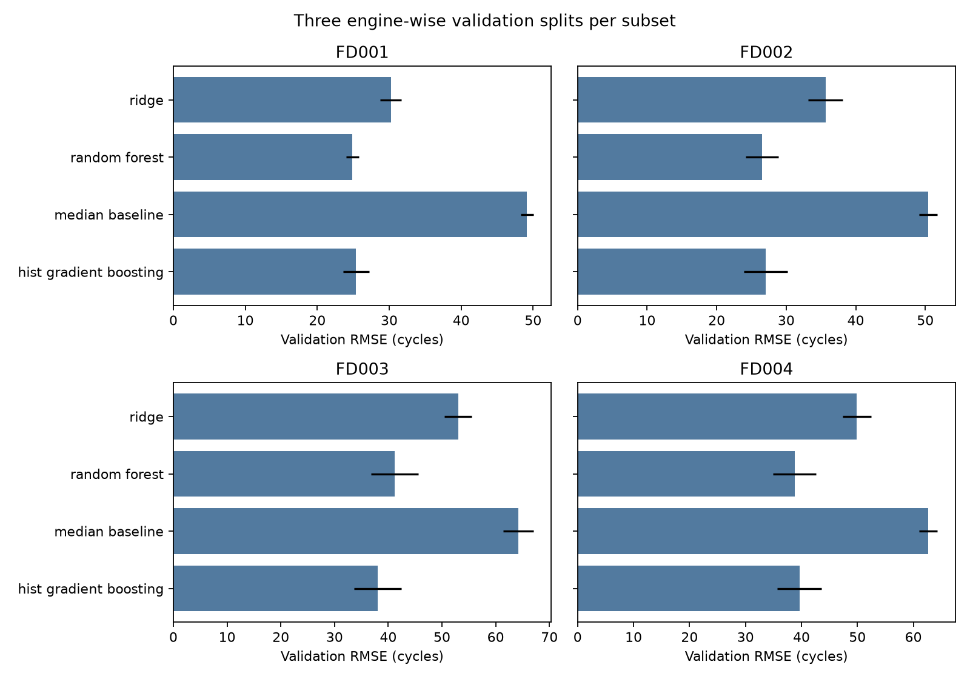
Robustness and limits
FD002 and FD004 change mean-RMSE leader under this audit.
Three repeats show sensitivity, not a confidence interval.
Simulated data and late-life overestimates prevent safety claims.
Notes:
Source: docs/ROBUSTNESS_ANALYSIS.md and reports/robustness/repeated_validation_rmse.png. This post-hoc audit uses three training-only engine splits and fixed 50%, 70%, 85% endpoints. It does not alter the official-test model choices.

